Slide 1
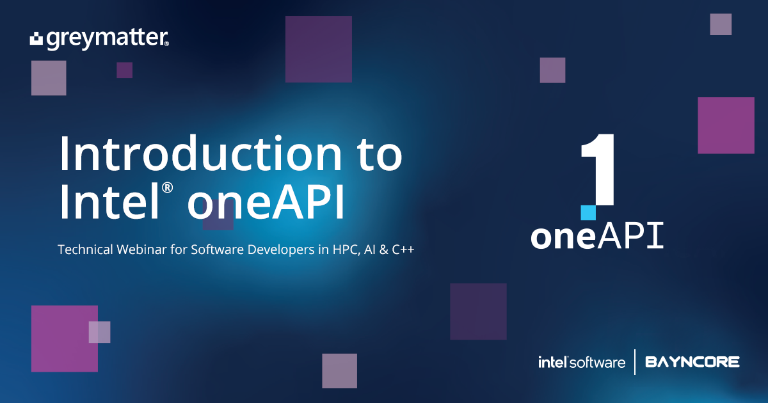

Air Pressure System (APS) Failure Prediction

Slide 2
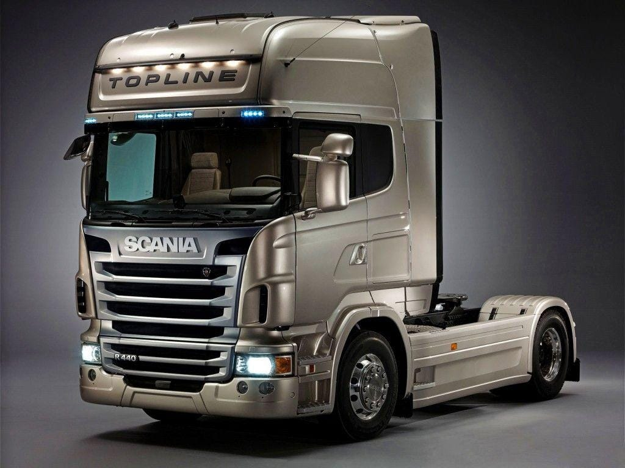

Scania Trucks, one of the largest truck producing company provided the data related to APS(air pressure system), one of the part in trucks. Among all different parts in truck, company especially want to know if the failure is related with APS or not. Basically the motive is to reduce the extra effort and time for unnecessary check of APS.
Problem Statement

Slide 3
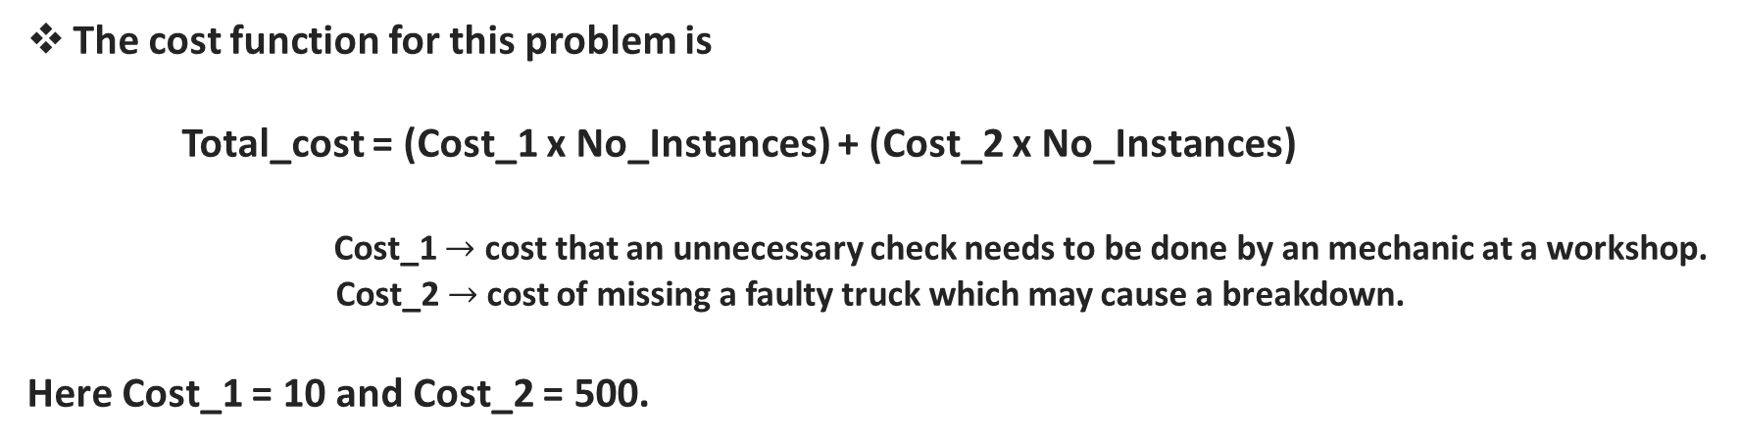
Machine Learning Statement
It is given that there is a failure in Truck, the task is to find weather the failure is related to APS or not. Simply in terms of Machine Learning it is a Binary Classification problem where there is only two possibilities:-
Failure related with APS.
Failure does not related with APS.
The cost function for this problem is
Total_cost = (Cost_1 x No_Instances) + (Cost_2 x No_Instances)
Cost_1 $→$ cost that an unnecessary check needs to be done by an mechanic at a workshop. Cost_2 $→$cost of missing a faulty truck which may cause a breakdown.
Here Cost_1 = 10 and Cost_2 = 500.

Slide 4
Dataset Description
The training set contains 36188 examples in total in which 35188 belong to the negative class and 1000 positive
The attribute names of the data have been anonymized for proprietary reasons. It consists of both single numerical counters and histograms consisting of bins with different conditions.
In total there are 171 attributes and one target variable.

Slide 5
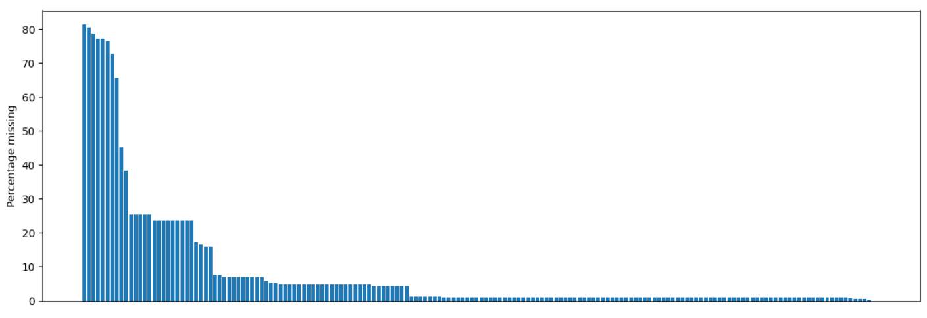
Dataset Analysis
Most of the columns in the dataset contains null values, some of them more contain 70%.

Slide 6
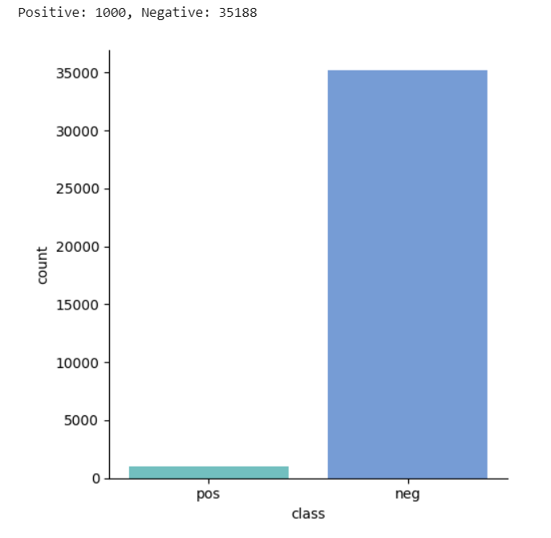
The Dataset is highly imbalanced.

Slide 7
Steps to run the Project

Slide 8
Please Note
As we can't get the data directly from the APS sensor, for time being we are using the dataset itself to send data to Kafka topic.

Slide 9
Step - 1
Run Producer file to send each instance of data to the Kafka topic
This may take a lot of time as there are nearly 36000 sensor data sample

Slide 10
Step - 2
Run Consumer file to extract the data from the Kafka topic and insert it into the database

Slide 11
Step - 3
Extract the data from MongoDB and save it as .csv file for further training process

Slide 12
Step - 4
Exploratory Data Analysis (EDA)
Experimenting the data with different Imputers to impute the null values in the dataset and Robust Scaler to the data.
Balance the Dataset
Training on different model of One DAL library and XgBoost library of Intel’s One API
Pick the Best performing model.

Slide 13
Thank You

